Slide 1

How do WE affect the Earth?
Energy, global warming and our contribution: a talk for Leighton Park School
Andrew Nind
2nd February 2017
Notes:
Close to heart, brief background, role of expert, holistic

Slide 2
100 years ago …
… there were 1.5 billion people living on the Earth using 60 * 10¹⁸ joules energy each year

Slide 3
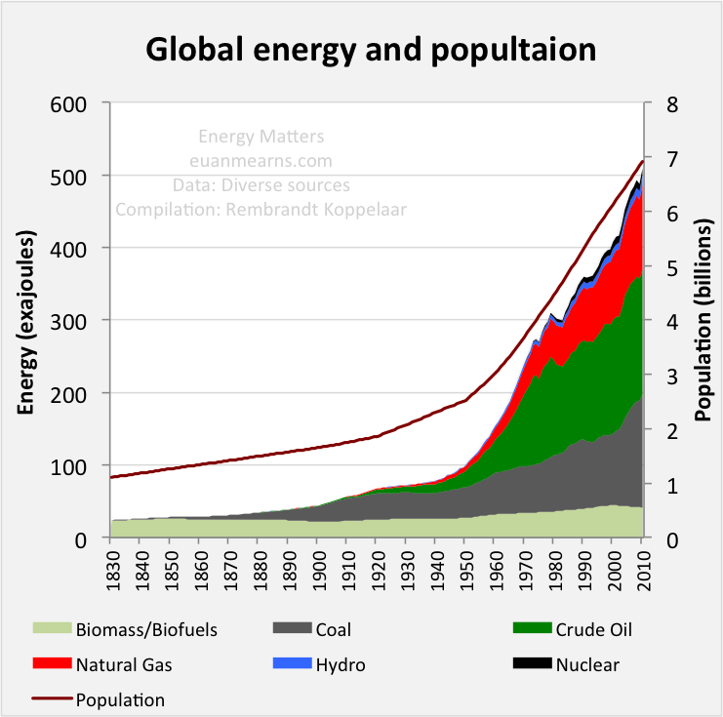
100 years ago …
… there were 1.5 billion people living on the Earth using 60 * 10¹⁸ joules energy each year
Today, there are 7.5 billion people living on the Earth using 600 * 10¹⁸ joules energy each year
Energy and population
Source: UN data, Vaclav Smil
Notes:
“energy use” loose language

Slide 4
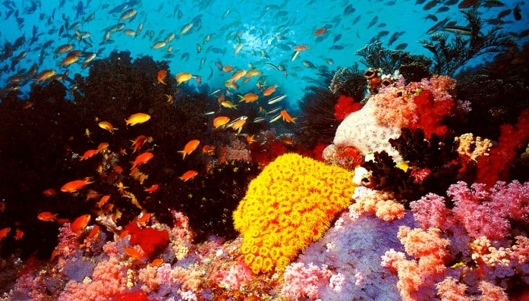
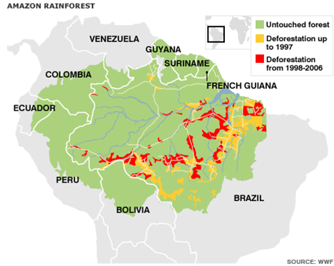
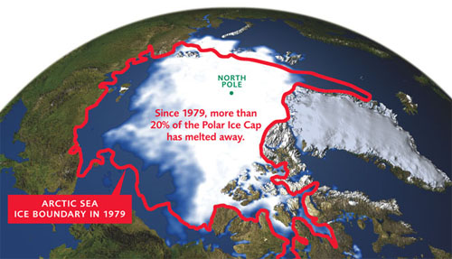
Evidence of global human impact on the environment
Great Barrier Reef – 50% loss in 30 years
Arctic Ice Shelf – 20% loss in 30 years
Amazon Rain Forest – 10% loss in 15 years
Source: David Attenborough, NASA, World Wildlife Fund
Notes:
What is causing this?

Slide 5
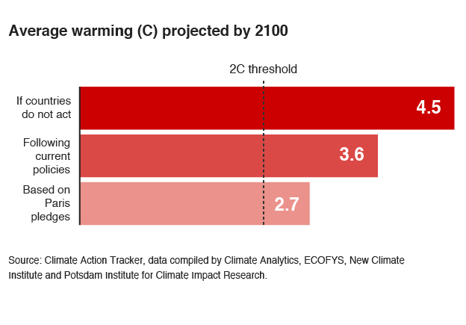
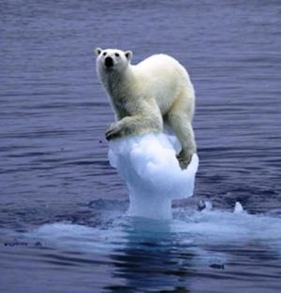
Projections of future global warming
Political promises will not prevent dangerous climate change, even if enacted
More storms, droughts, land covered by rising seas, loss of jungles and animals, ocean acidity and loss of fish, growing deserts and widespread famine
Notes:
David King – already have dangerous climate change, UN Summit COP21

Slide 6
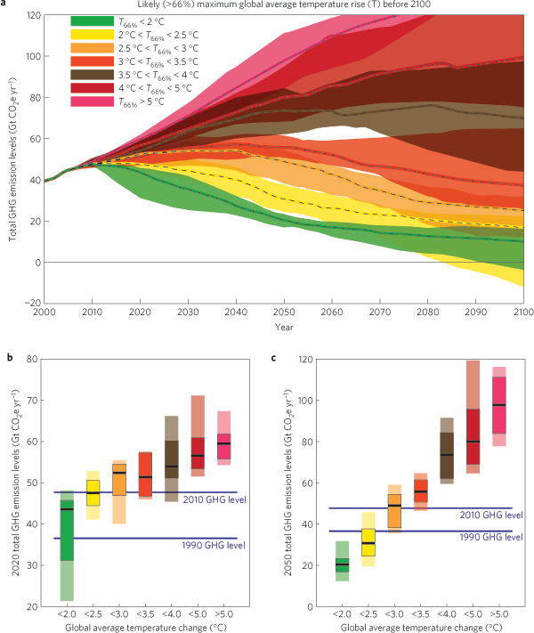
Human beings need to halve emissions to prevent catastrophic global warming
Reduction required by 2050
10 tonnes CO2e per 4-person family
http://www.pbl.nl/en/publications/2011/emission-pathways-consistent-with-a-2%E2%80%89-degree-global-temperature-limit
Also referred to by Committee on Climate Change (2014) and Chatham House report (2015)
Notes:
CO2e

Slide 7
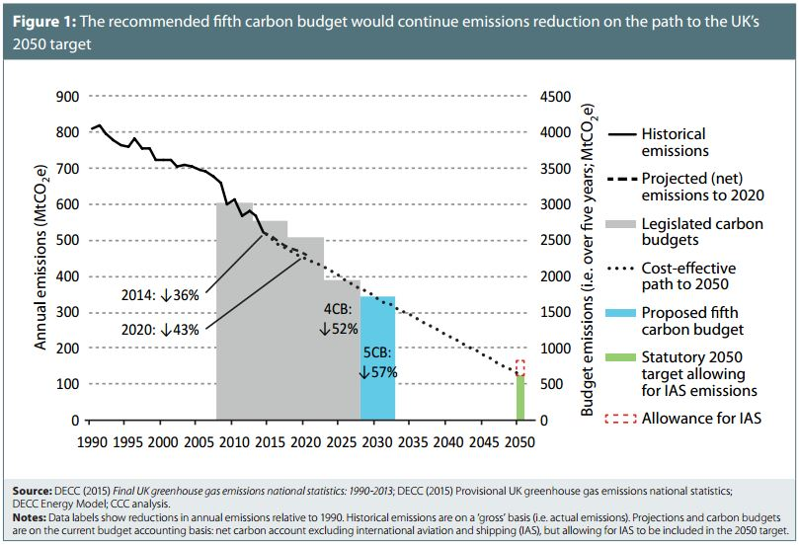
At least in Britain, we’re doing our bit …
Notes:
Role of CCC, carbon budgets, CCC website, beg of July, concept of budget

Slide 8
At least in Britain, we’re doing our bit … or are we?
CCC website FAQ Number 12) Despite reports of falling UK emissions, hasn’t our real carbon footprint actually risen?
“The fall in emissions within the UK is real, reflecting - for example – reductions in emissions from power generation. But if we look at consumption emissions, then yes, our analysis suggests that our carbon footprint has increased since 1993, as growth in imported emissions has more than offset the reduction in emissions produced within the UK.
This increase in imported emissions is largely a result of rising incomes, with associated increased demand for consumer goods, many of them imported. This emphasises the need for policies globally to reduce emissions. It is very encouraging in this respect that countries, including China and the US*, have made ambitious commitments to reduce emissions. There is now widespread coverage by low-carbon policies of major emitting sectors around the world. The UK is not acting alone.”
*China and US together made up about 45% of world CO2 emissions in 2011.
Source: Committee on Climate Change website, FAQ, January 2017 (my underlining)
Notes:
Weasel words, paraphrase, outsource,

Slide 9
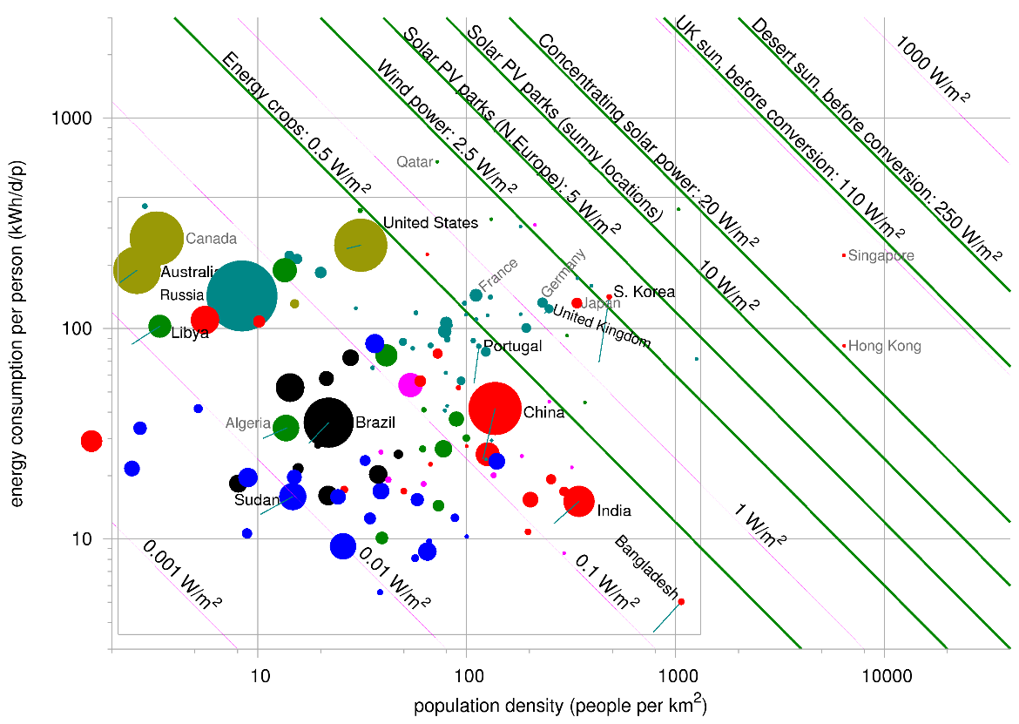
Energy usage by different countries
Notes:
David Mackay Energy Map,

Slide 10
Energy usage by different countries
Extravagant --------------->
Crowded --------------->
http://www.inference.eng.cam.ac.uk/sustainable/data/powerd/MapOfWorld.html
Notes:
location

Slide 11
What the slide shows
In the UK, human beings use more energy per unit of land area than in almost any other country on earth
  US, Canada and Australia: individuals use more but population density is much lower
  India and Bangladesh: there is higher population density but individuals use much less
  Japan is main exception
In the UK, we would have to cover the entire country with windmills to meet our energy needs in full from onshore wind
Solar has more potential than wind but as of 2017 the UK would need about 250 times as much solar power as we have currently to meet our total energy needs here
Solar power developed in sunny countries could meet the world’s energy needs
Notes:
Read out

Slide 12
How do WE affect the Earth?
Notes:
Spend a minute

Slide 13
How do WE affect the Earth?
HEATING & A.C.
TRANSPORT
ELECTRICITY
BUYING STUFF
FOOD

Slide 14
How do WE affect the Earth?
GHG based on an average 4-person household in Britain, as of 2016
Sources: UK government (DECC, DEFRA), Oxford University, Chatham House, ONS, National Grid, United Nations, RAC, IATA, European Commission
Notes:
Per capita*4, research anyone can do

Slide 15
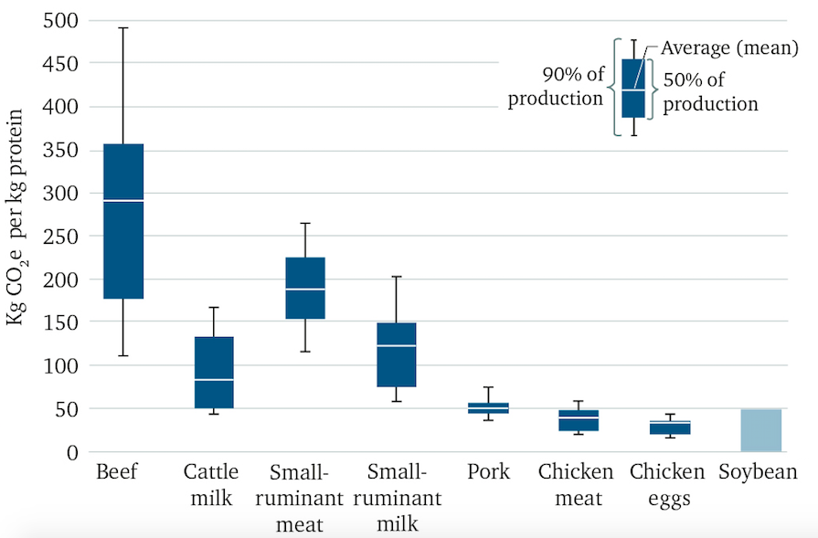
Food digression: the relative impact of different foods
Source: Chatham House 2015
Notes:
Less extreme than Cowspiracy!, lot of uncertainty but ranking is clear, note optimisation of chicken and pork – no freedom to roam and short lives!

Slide 16
Chatham House 2015 report
“If we are to avoid dangerous climate change, global yearly emissions must fall rapidly from today’s level of 49 GtCO2e to around 23 GtCO2e by 2050. If meat and dairy consumption continues to rise at current rates, the agricultural sector alone will soak up 20 of the 23 GtCO2e yearly limit in 2050, leaving just 3 GtCO2e for the rest of the global economy …”
https://www.chathamhouse.org/sites/files/chathamhouse/publications/research/CHHJ3820%20Diet%20and%20climate%20change%2018.11.15_WEB_NEW.pdf

Slide 17
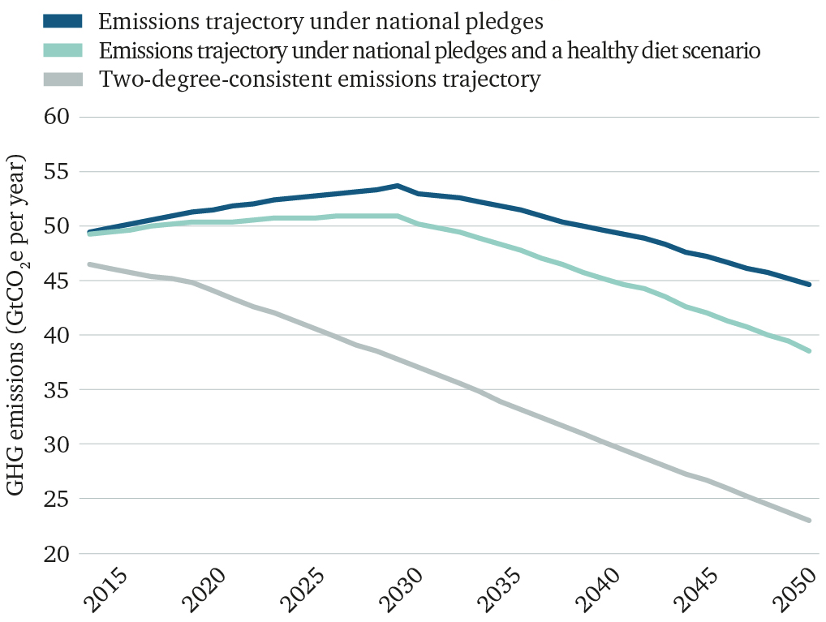
Chatham House 2015 report
Notes:
Eating healthily is helpful but not enough

Slide 18
How do WE affect the Earth?
reduction needed
sustainable level
GHG based on an average 4-person family in Britain
Sources for sustainable level: Committee on Climate Change 2015, Netherlands Dept of Environment, Chatham House 2015

Slide 19
Can nuclear, wind and solar save us?
savings possible
This shows the savings if all electricity globally is zero carbon, before further electrification of transport and heating is considered
Sources for sustainable level: Committee on Climate Change 2015, Netherlands Dept of Environment, Chatham House 2015
Notes:
Most emphasis is on power stations … impact limited!

Slide 20
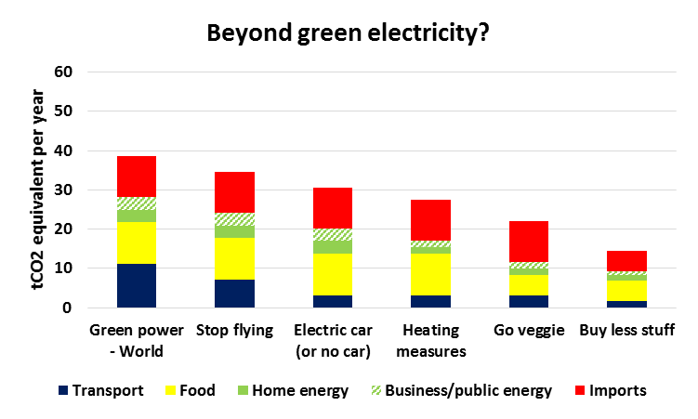
What can WE do to help?
savings possible
Sources for sustainable level: Committee on Climate Change 2015, Netherlands Dept of Environment, Chatham House 2015
Notes:
Follow on …few %,

Slide 21

Every little BIG helps
X
BIG HELP?
Travel less in cars and planes, carbon offset
X
Turn off television/computer; don’t leave on standby
Go vegetarian 6 days out of 7
X
Turn off dripping taps
Shop less, keep things longer
X
Buy local apples rather than imported apples
Turn the heating down, live together

Slide 22
A few thoughts on psychological barriers to change
Pessimism – give up
Optimism – decide there’s no need to change
Vicarious atonement – abdicate responsibility to government (which leaves it up to us!)
Disavowal – decide I am insignificant so what I do doesn’t matter
We must not waste time casting blame (on government, rich, old, oil companies, other countries, …)
We must take responsibility for our own lives, and fight for a different way of life
Notes:
Marianne Williamson

Slide 24
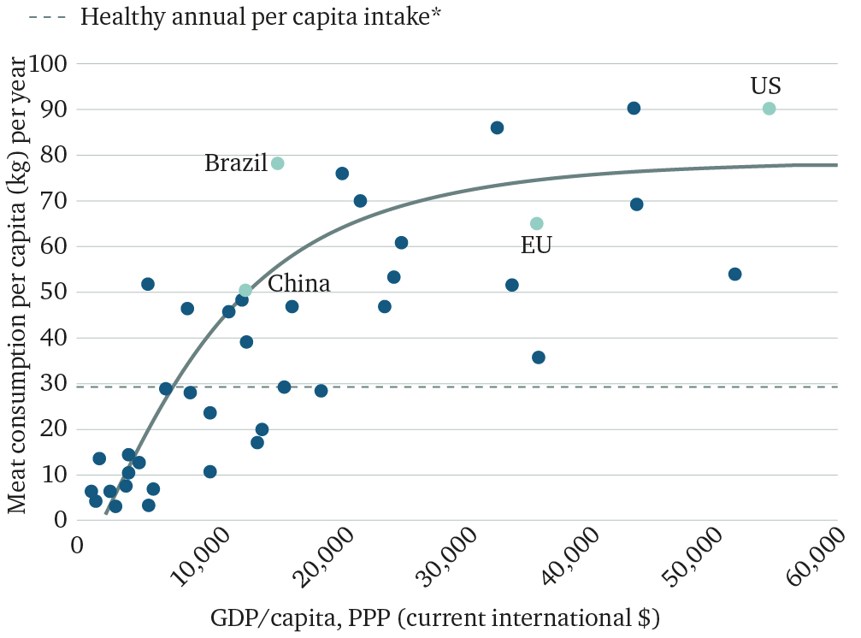
Chatham House 2015 report

